Slide 1
Vistec #2
Alignment
PEC (Proximity Effect Correction)
Undercut with 100 kV

Slide 2
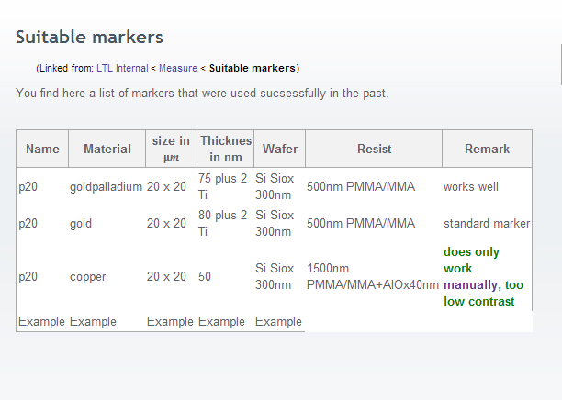
Alignment (works :c)
Alignment marks 20 x 20 µm
Joy marker

Slide 3
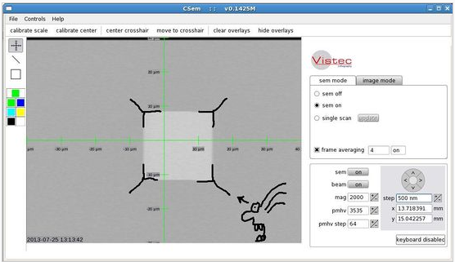
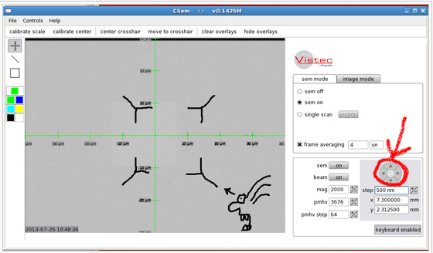
Alignment
Alignment marks 20 x 20 µm
Kiitos Anna!

Slide 4
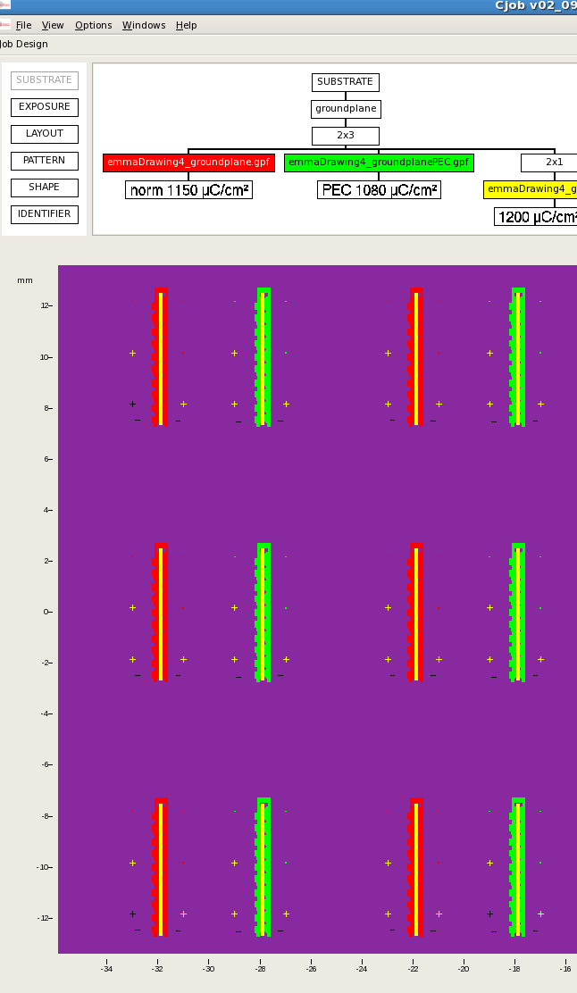
Alignment (works :c) )
Alignment marks 20 x 20 µm
One premarker
Rotation of wafer with optical microscope
10 nm over full wafer
Additional: marker for each structure
Kiitos Emma!

Slide 5
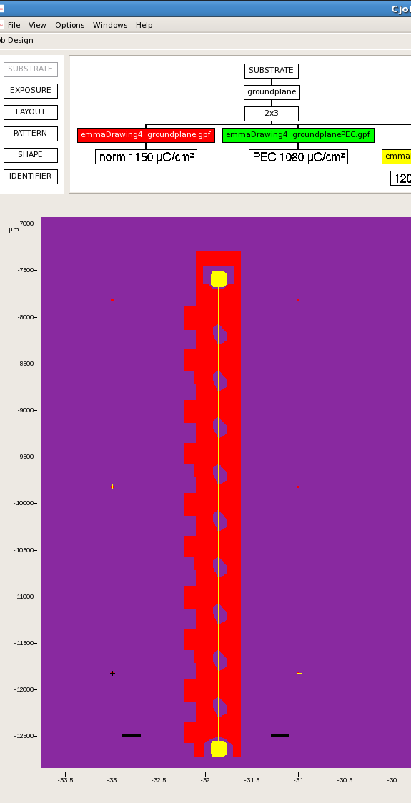
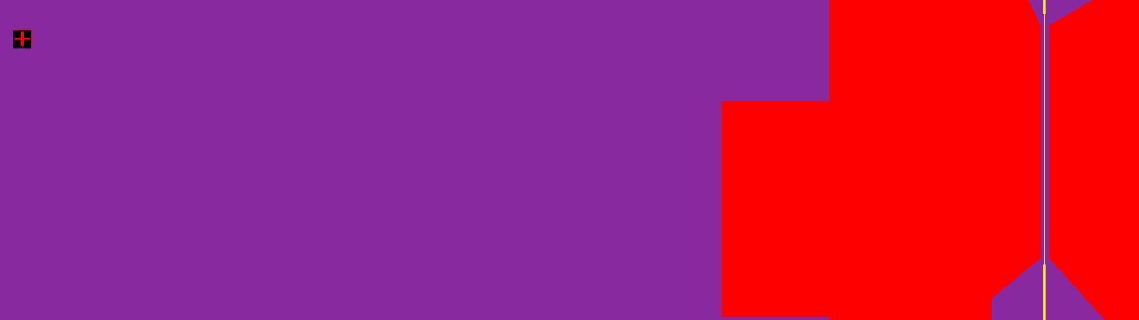
Alignment (works :c) )
Alignment marks 20 x 20 µm
Kiitos Emma!

Slide 6
Alignment (works :c) )
Alignment marks 20 x 20 µm, spacing 3 mm
Kiitos Emma!

Slide 7
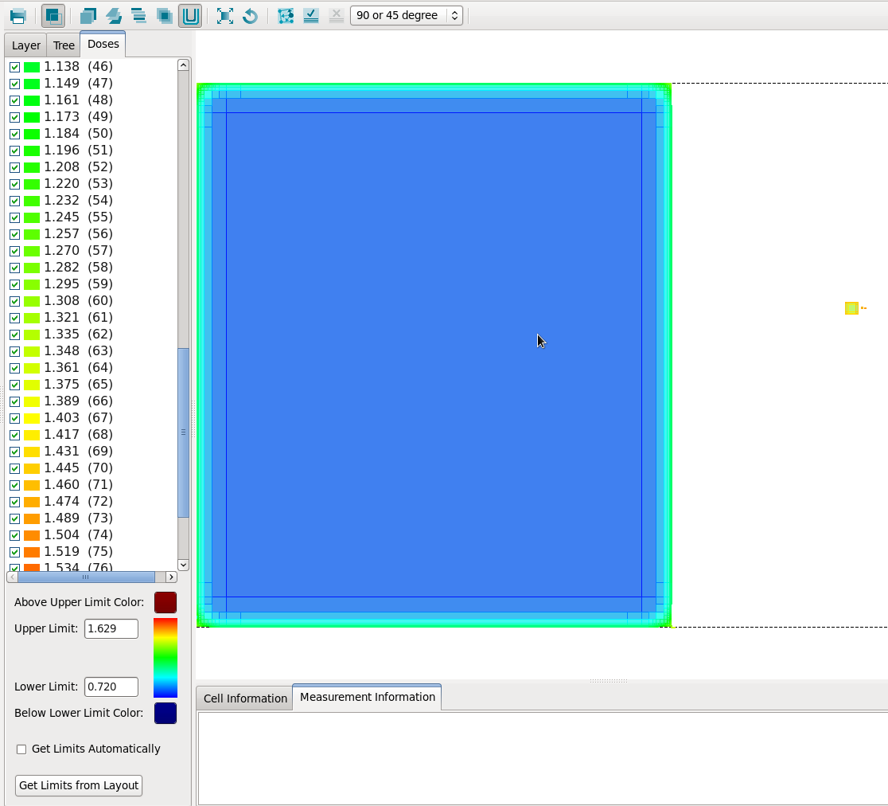
PEC (Proximity Effect Correction) 90k€ = 10 Lupitos
Only PEC,
not dose (size)?!!

Slide 8
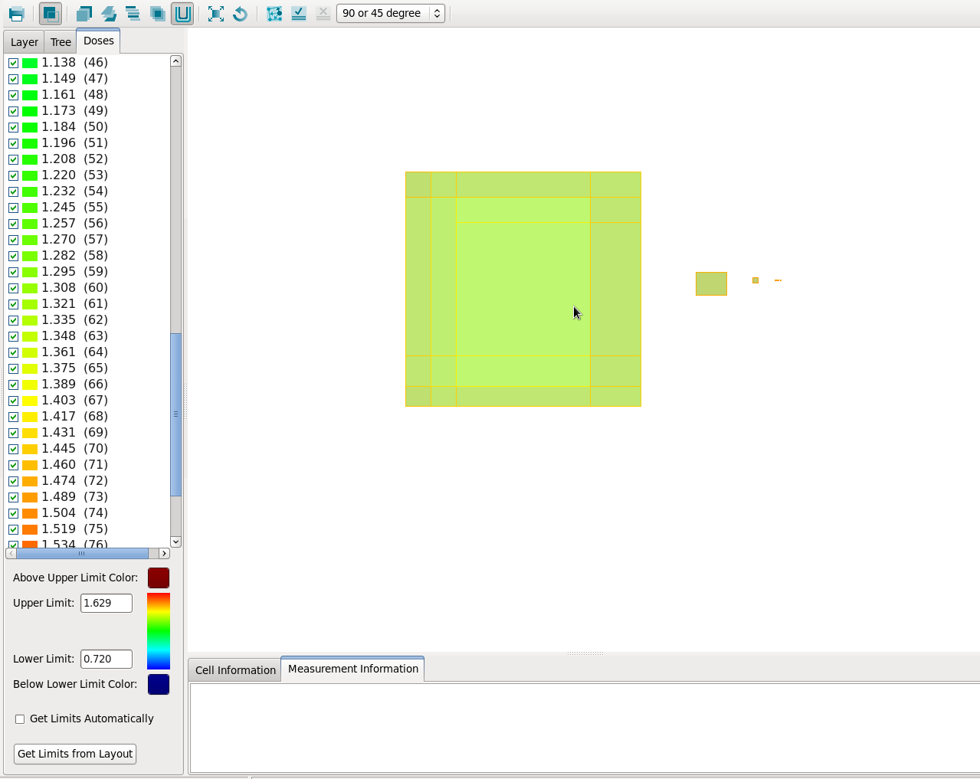
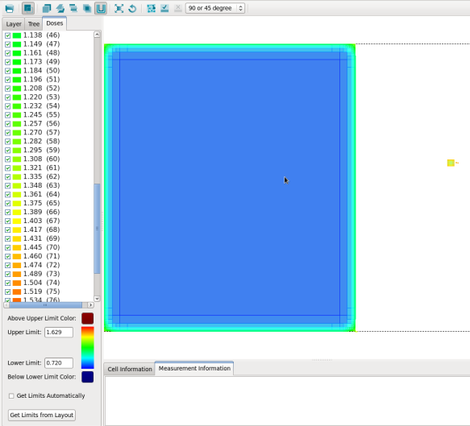
PEC (Proximity Effect Correction)
Only PEC,
not dose (size)?!!

Slide 9
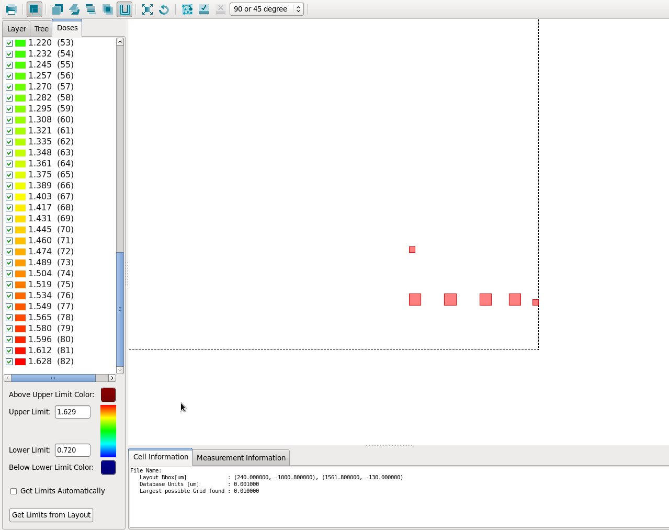

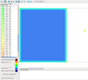
PEC (Proximity Effect Correction)
Only PEC,
not dose (size)?!!
Oops, it works?!!??

Slide 10
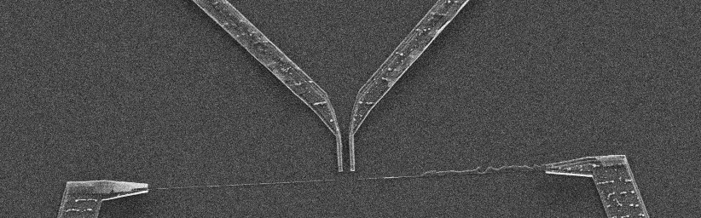
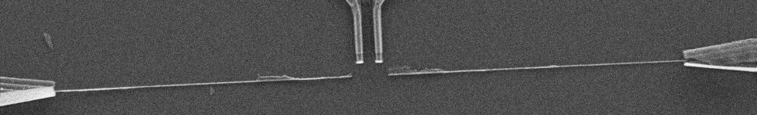
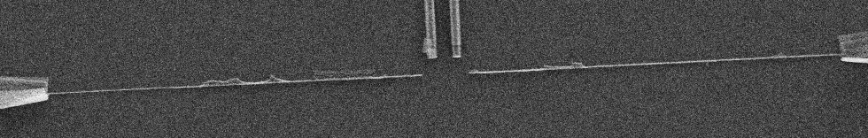
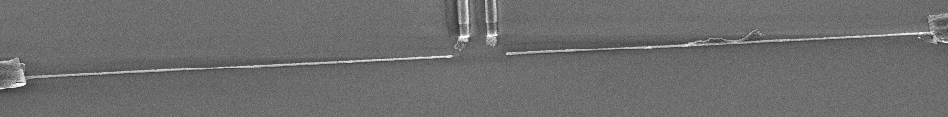
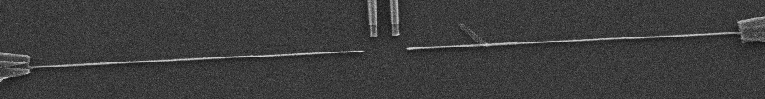
Undercut with 100 kV/dosetest
1000µC/cm2
1200µC/cm2
1400µC/cm2
1800µC/cm2
2000µC/cm2
Kiitos Klaara!

Slide 11
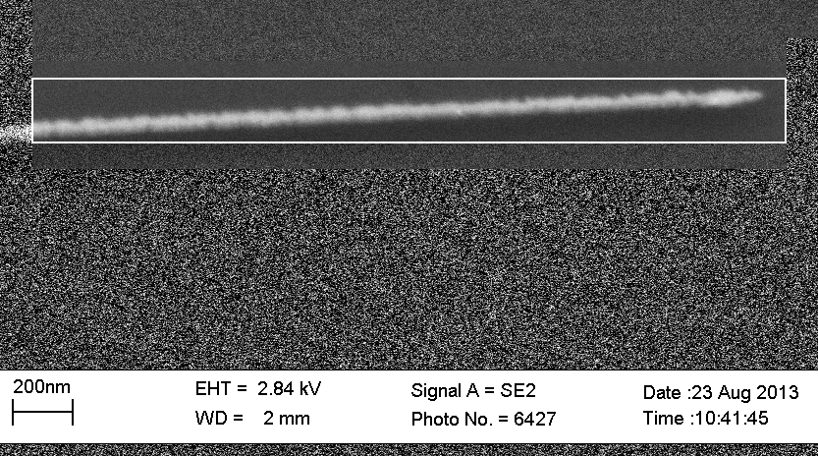
Undercut with 100 kV/dosetest
2000µC/cm2
Kiitos Klaara!

Slide 12
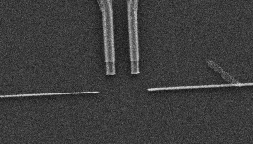
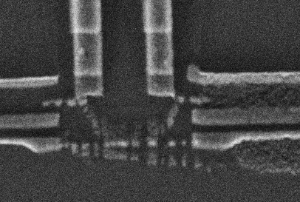
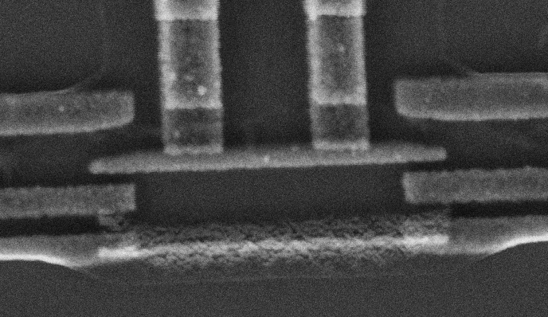
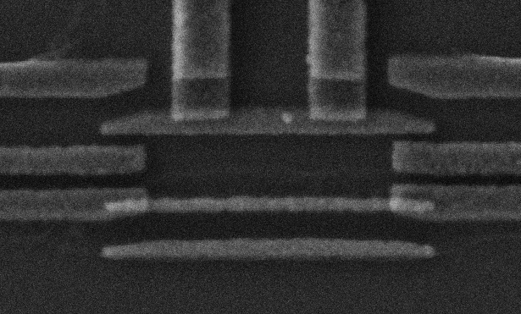
Undercut with 100 kV/dose 2000µC/cm2 MIBK 20s Methanol:Methylglycol 2:1
No MG
10s MG
20s MG
30s MG
Kiitos Klaara!

Slide 13
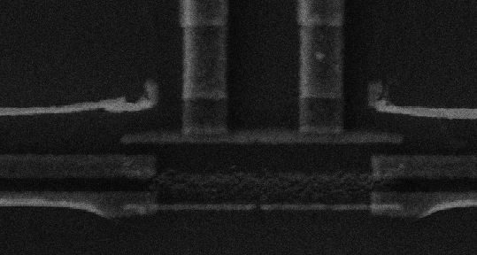
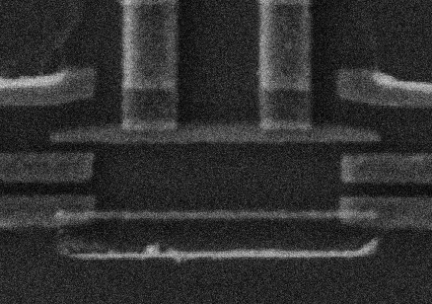
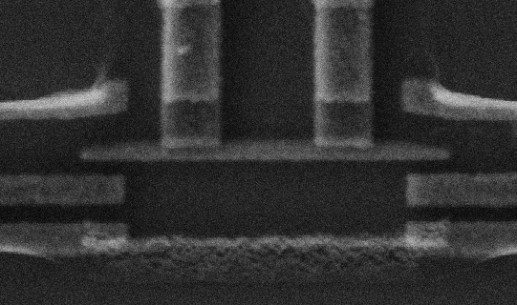
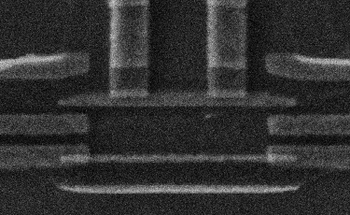
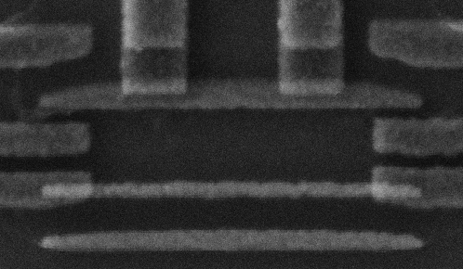
Undercut with 100 kV/dosetest
30s Methanol:Methylglycol 2:1
1000µC/cm2
1513µC/cm2
1305µC/cm2
1650µC/cm2
Kiitos Klaara!
1916µC/cm2

Slide 14
Vistec #2
Alignment
PEC (Proximity Effect Correction)
Undercut with 100 kV

